Slide 1

Automated Face Recognition using Artificial Neural Networks.

Slide 2
الشعبة | المستوي | ID | الاسم
نظم المعلومات | الثالت | 202000033 | احمد خليل عبدالمغني خليل
نظم المعلومات | الثالث | 202000106 | اروي محمود عبدالوهاب محمد
نظم المعلومات | الثالث | 202000941 | منة الله القطب محمد محمد
نظم المعلومات | الثالث | 202000646 | فرح اشرف محمود عبد الغنى
نظم المعلومات | الثالث | 202000029 | احمد حسين محمد إبراهيم
نظم المعلومات | الثالث | 202000141 | الاء محمد رمضان حسب

Slide 3
contents
1.OVERVIE
1.0.Abstract………………………………………………………………………………………………………………………………………………………………………...………………………5
1.2.Introduction………………………………………………………………………………………………………………………………………………………………………………………….6
2. facial recognition
2.0. How does facial recognition work……………………………………………………………………………………………………………………………….……………7
2.1.Project idea………………………………………………………………………………………………………………………………………………………………..………………………..9
2.2. APPLICATION OF THIS RESEARCH………………………………………………………………………………………………………………………………………….10
2.3. Similar applications in the market………………………………………………………………………………………..………………………………………………..12
2.4.LITERATURE REVIEW FOR FACE recognition……………...........………………………………………………………………………………….....………….16
3. Proposed Solution & Dataset
3.1. Main functionalities/features and use case…………………………………………………………………………………………………………...……………26
3.2. the Dataset employed..............………………………………………………………………………………………………………………………………………………….27
4. Artificial Neural Network algorithm[ANN]&[CNN]
4.1. What is [ANN]Neural Network……………………………………………………………………………..………………………………………………………………29
4.2. Why we use [ANN]Neural network……………………………………………………………………………………………………………………………………30
4.3. What is [CNN]Neural Network……………………………………………………………………………………………………………………………………………31

Slide 4
4.4. Flow chart…………………………………………………………………………………………………..............................................................................36
4.5. block diagram……………………………………………………………………………………………………………………………………………………………………………37
4.6. flow diagram…………………………………………………………………………………………………………………………………………………………………………...…38
4.7.DEVELOPMENT PLATFORM..............................………………………………………………………………………………………………….........……39
5. Experiments & Results
5.1. Plots of the evolution or training…………………………………………………………………………………………………………………………………………40
5.2. samples of the output……………………………………………………………………………………………………………………………………..........……………….41
5.3. The results and insights ……………………………………….…………………………………………………………………………………………………………………43
5.4. Why did the algorithm [ANN] behave in such a way?……………………………………………………………………………………….......44
5.5. Why did the algorithm [CNN] behave in such a way?………………….........................................................................46
5.6. Pros & cons of facial recognition………………………........…………………………………………………………………………………………………………48
5.7. Future Work..................................………………………........…………………………………………………………………………………………………………50

Slide 5
Abstract
Face recognition from the real data, capture images, sensor images and database images is challenging problem due to the wide variation of face appearances, illumination effect and the complexity of the image background. Face recognition is one of the most effective and relevant applications of image processing and biometric systems. In this paper we are discussing the face recognition methods, algorithms proposed by many researchers using artificial neural networks (ANN) which have been used in the field of image processing and pattern recognition. How ANN will used for the face recognition system and how it is effective than another methods will also discuss in this paper. There are many ANN proposed methods which give overview face recognition using ANN. Therefore, this research includes a general review of face detection studies and systems which based on different ANN approaches and algorithms. The strengths and limitations of these literature studies and systems were included, and also the performance analysis of different ANN approach and algorithm is analysing in this research study.

Slide 6
INTRODUCTION :
The subject of face recognition is as old as computer vision, Despite the fact that other methods of identification (such as fingerprints, or iris scans) can be more accurate, face recognition has always remained a major focus of research because of its non-invasive nature and because it is people's primary method of person identification. Much of the work in computer recognition of faces has focused on detecting individual features such as the eyes, nose, mouth, and head outline, and defining a face model by the position, size, and relationships among these features. When comparing the differences between different biometrics, we can see that the cost of facial recognition is low, the acceptance from user is easy, and the acquisition of information is easy.

Slide 7
How does facial recognition work?
Facial recognition works in three steps: detection, analysis, and recognition.
Step 1: Face detection
The camera detects and locates the image of a face, either alone or in a crowd. The image may show the person looking straight ahead or in profile.
Step 2: Face analysis
Next, an image of the face is captured and analyzed. Most facial recognition technology relies on 2D rather than 3D images because it can more conveniently match a 2D image with public photos or those in a database. The software reads the geometry of your face. Key factors include the distance between your eyes, the depth of your eye sockets, the distance from forehead to chin, the shape of your cheekbones, and the contour of the lips, ears, and chin. The aim is to identify the facial landmarks that are key to distinguishing your face.

Slide 8
Step 3: Converting the image to data
The face capture process transforms analog information (a face) into a set of digital information (data) based on the person's facial features. Your face's analysis is essentially turned into a mathematical formula. The numerical code is called a faceprint. In the same way that thumbprints are unique, each person has their own faceprint.
Step 4: Finding a match
Your faceprint is then compared against a database of other known faces. For example, the FBI has access to up to 650 million photos, drawn from various state databases. On Facebook, any photo tagged with a person’s name becomes a part of Facebook's database, which may also be used for facial recognition. If your faceprint matches an image in a facial recognition database, then a determination is made.
Of all the biometric measurements, facial recognition is considered the most natural. Intuitively, this makes sense, since we typically recognize ourselves and others by looking at faces, rather than thumbprints and irises. It is estimated that over half of the world's population is touched by facial recognition technology regularly.

Slide 9
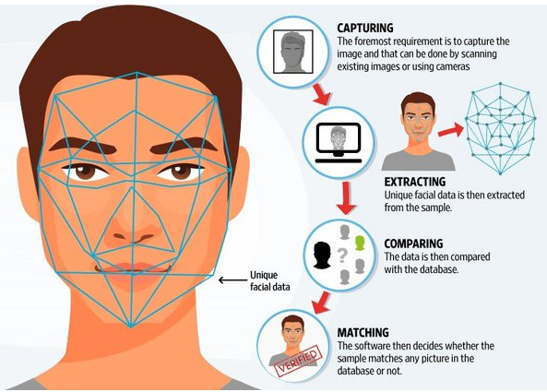
project idea :​
a system which can identify the person with the help of a face using artificial neural network technique. This system is implemented in two stages. They are the learning stage and the testing stage. Image acquisition, pre-processing , image filtering, feature extraction and learning are included in the learning stage.

Slide 10
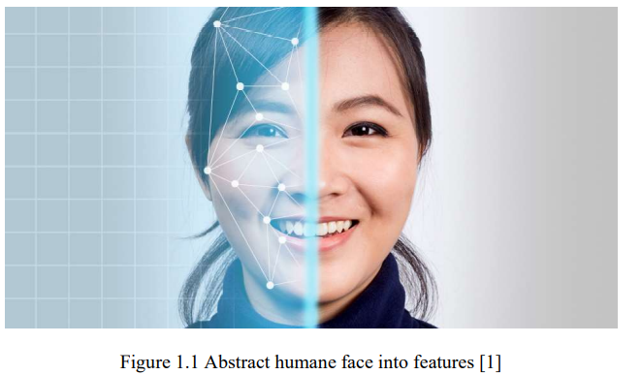
APPLICATION OF THIS RESEARCH
Some traditional face recognition algorithms identify facial features by extracting landmarks, or features, from an image of the subject's face. For example, as shown in Figure 1.1, an algorithm may analyze the relative position, size, and/or shape of the eyes, nose, cheekbones, and jaw. These features are then used to search for other images with matching features.

Slide 11
face recognition technology in various industries.
Banking
Facial recognition is one of the ways banks can boost productivity and usability for their clients by reducing friction. It assists in preventing unauthorized persons from acquiring access to restricted areas of a bank and capturing unusual activity on camera.
Access Control
Outside of cars and smartphones, facial recognition can be used in the home to grant access to certain IoT devices in addition to entry into the home itself. As this technology becomes more and more advanced, people will feel better protected against home invasions and robberies.
Loyalty programs
Integrated into a store's CCTV cameras, facial recognition technology can help retailers reward loyal customers without interrupting their buying experience. The moment a loyalty club member enters a store the facial recognition system identifies the customer and, say, rewards them with a personalized discount or informs them about deals or products they might be interested in.
Human-Computer Interaction Currently some computer games can be played with head movement, instead of mouse or keyboard (but the player must wear headgear).

Slide 12


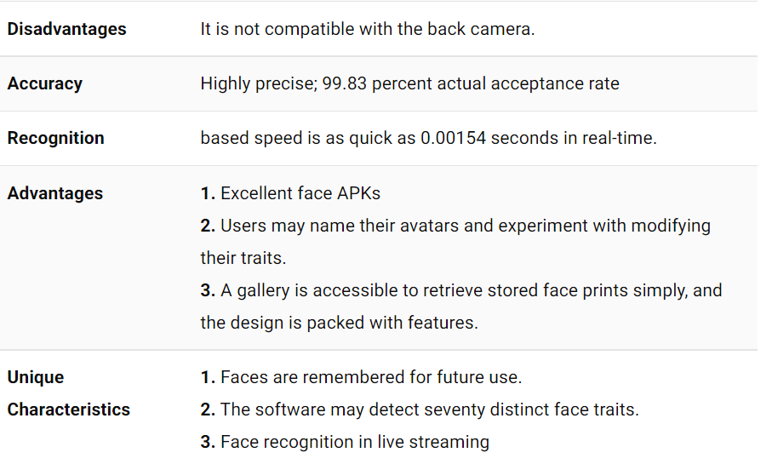
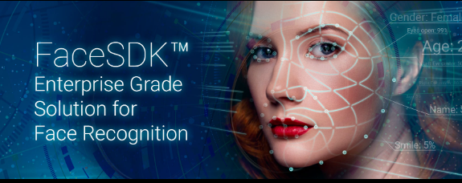
Similar applications in the market
* Lux and Face Recognition : https://www.luxand.com/
This app allows you to tap a detected face and give it a name. Also, it helps recognize and memorize that face ahead. All you need to do is hold your device at your arm’s length and rotate it slowly at multiple views changing the location, and the app will recognize it. This app has the caliber to memorize various persons; if it doesn’t, you must repeat the process

Slide 13
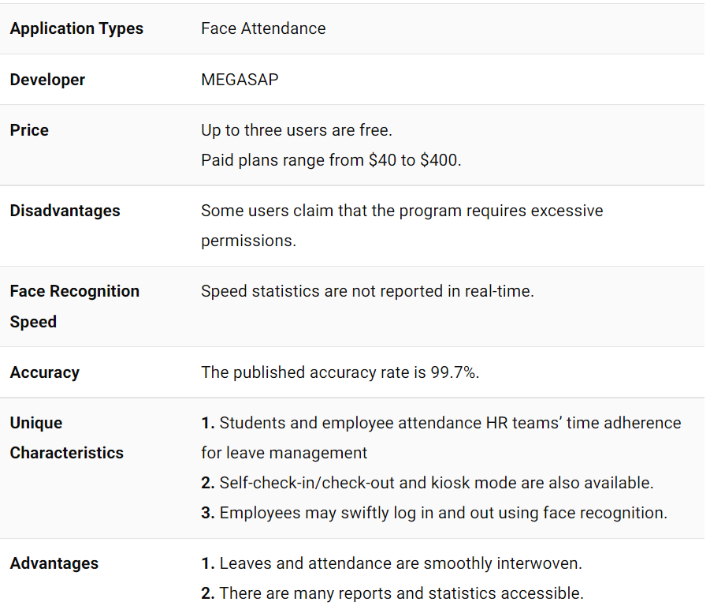

Railer – Face Attendance : https://www.emizentech.com/blog/best-face-recognition-apps.html
With the face recognition and mobile attendance management app, Railer helps in employee check-in, check-out quickly maintains time attendance, leave management, analytics and reporting, and much more.

Slide 14
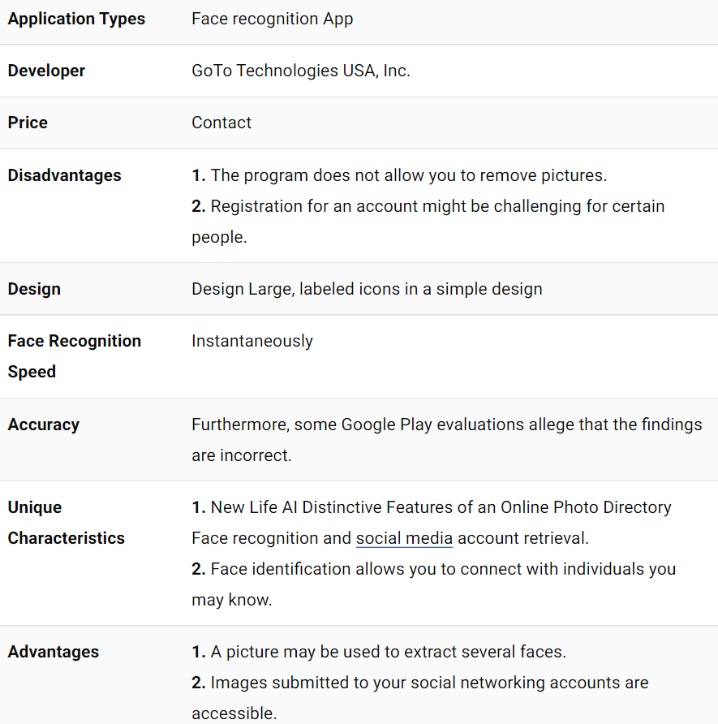

LogMeIn : https://www.logmein.com/
Now, you can get secure computer access anytime, anywhere from your Android device. Moreover, you can access your data, files, and apps and do the stuff you need to perform. So, you will get everything at your fingertips.

Slide 15
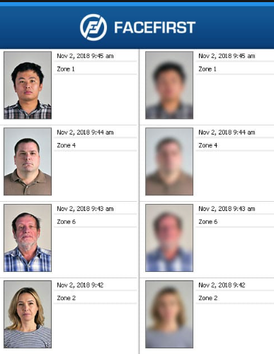
FACEFIRST : https://www.logmein.com/
FaceFirst is a popular choice in the face recognition apps category in law enforcement and the military, which helps in matching photographs of personnel in the field almost instantly against their databases.
This face recognition app is used to find out the identity of individuals, which can help law enforcement officers improve the security of the community while making sure that they do not engage in any false arrests.
Not only that, but officers can also use FaceFirst to create
a watchlist in which they can enroll
suspected criminals while they are on-ground
performing their duties.
Facial Recognition App Category: Law Enforcement App
Price: Free

Slide 16
Hindawi Publishing Corporation Advances in Artificial Neural Systems Volume 2011, Article ID 673016, 16 pages doi:10.1155/2011/673016
Research Article
Applying Artificial Neural Networks for Face Recognition
Thai Hoang Le
Department of Computer Science, Ho Chi Minh University of Science, Ho Chi Minh City 70000, Vietnam
Correspondence should be addressed to Thai Hoang Le, lhthai@fit.hcmus.edu.vn Received 25 January 2011; Revised 16 June 2011; Accepted 19 July 2011 Academic Editor: Naoyuki Kubota
Copyright © 2011 Thai Hoang Le. This is an open access article distributed under the Creative Commons Attribution License, which permits unrestricted use, distribution, and reproduction in any medium, provided the original work is properly cited.
This paper introduces some novel models for all steps of a face recognition system. In the step of face detection, we propose a hybrid model combining AdaBoost and Artificial Neural Network (ABANN) to solve the process eﬃciently. In the next step, labeled faces detected by ABANN will be aligned by Active Shape Model and Multi Layer Perceptron. In this alignment step, we propose a new 2D local texture model based on Multi Layer Perceptron. The classifier of the model significantly improves the accuracy and the robustness of local searching on faces with expression variation and ambiguous contours. In the feature extraction step, we describe a methodology for improving the eﬃciency by the association of two methods: geometric feature based method and Independent Component Analysis method. In the face matching step, we apply a model combining many Neural Networks for matching geometric features of human face. The model links many Neural Networks together, so we call it Multi Artificial Neural Network. MIT + CMU database is used for evaluating our proposed methods for face detection and alignment. Finally, the experimental results of all steps on CallTech database show the feasibility of our proposed model.
1. Introduction
properties such illumination and gray scale. After a face is normalized geometrically and photometrically, feature extraction is performed to provide eﬀective information that is useful for distinguishing between faces of diﬀerent persons and stable with respect to the geometrical and photometrical variations. For face matching, the extracted feature vector of the input face is matched against those of enrolled faces in the database; it outputs the identity of the face when a match is found with suﬃcient confidence or indicates an unknown face otherwise.
Artificial neural networks were successfully applied for
solving signal processing problems in 20 years [2]. Research- ers proposed many diﬀerent models of artificial neural net- works. A challenge is to identify the most appropriate neural network model which can work reliably for solving realistic problem.
This paper provides some basic neural network models
and eﬃciently applies these models in modules of face recognition system. For face detection module, a three-layer feedforward artificial neural network with Tanh activation function is proposed that combines AdaBoost to detect human faces so that face detecting rate is rather high. For face alignment module, a multilayer perceptron (MLP)
Face recognition is a visual pattern recognition problem. In detail, a face recognition system with the input of an arbitrary image will search in database to output people’s identification in the input image. A face recognition system generally consists of four modules as depicted in Figure 1: detection, alignment, feature extraction, and matching, where localization and normalization (face detection and alignment) are processing steps before face recognition (facial feature extraction and matching) is performed [1].
Face detection segments the face areas from the back-
ground. In the case of video, the detected faces may need to be tracked using a face tracking component. Face alignment aims at achieving more accurate localization and at normalizing faces thereby, whereas face detection provides coarse estimates of the location and scale of each detected face. Facial components, such as eyes, nose, and mouth and facial outline, are located; based on the location points, the input face image is normalized with respect to geometrical properties, such as size and pose, using geometrical transforms or morphing. The face is usually further normalized with respect to photometrical

Slide 17
2
Advances in Artificial Neural Systems
Face
location size & pose
Aligned
Feature
Image
Face
detection tracking
Face alignment
face
Feature extraction
Vector
Feature matching
Face ID
Enrolled users
Figure 1: Structure of a face recognition system.
with linear function (three-layer) is proposed, and it creates 2D local texture model for the active shape model (ASM) local searching. For feature extraction module, a method for combination of geometric feature-based method and ICA method in facial feature extraction is proposed. For face matching, a model which combines many artificial neural networks applied for geometric features classification is proposed. This case study demonstrates how to solve face re cognition in the neural network paradigm. Figure 2 illustrates algorithms for the steps of the face recognition system.
The face detection and alignment steps are conducted
on MIT + CMU test set [3] in order to evaluate eﬀectively the performance. Then, the system, which is built from The proposed models, is conducted on CalTech database [4]. Experimental results show that our method performs favorably compared to state-of-the-art methods.
The paper is structured as follows: Section 2 will de-
scribe in detail the applying of AdaBoost and artificial neu- ral network for detecting faces. Section 3 will present an ASM method with a novel local texture model, which uses multilayer perceptron (MLP) for ASM local searching. Section 4 will describe a methodology for improving the eﬃciency of feature extraction stage based on the associa- tion of two methods: geometric feature-based method and independent component analysis (ICA) method. Section 5 will present multiartificial neural network (MANN) and MANN application for face matching. The experimental re- sults are presented in Section 6. Conclusions are mentioned in Section 7.
One of the most popular and eﬃcient learning machine- based approaches for detecting faces is AdaBoost approach [6]. Viola and Jones designed a fast, robust face detection system where AdaBoost learning is used to build nonlinear classifiers. AdaBoost is used to solve the following three fundamental problems: (1) learning eﬀective features from a large feature set; (2) constructing weak classifiers, each of which is based on one of the selected features; (3) boosting the weak classifiers to construct a strong classifier. Viola and Jones make use of several techniques for eﬀective computation of a large number of such features under varying scale and location which is important for real- time performance. Moreover, the cascade of strong classifiers which form cascade tree will make the computation even more eﬃcient. Their system is the first real-time frontal-view face detector. However, their system still has some drawbacks. Since the detection results depend on weak classifiers, the detection results often have many false positives. To decrease the rate of false positives, it is compelled to increase the number of strong classifiers and Haar-like features in cascade tree, but this will cause a significant increase in the performance time, and detection rate can be decreased. Thus, to deal with the issue, we should combine AdaBoost with other machine learning techniques to achieve the same face detecting ratios but with the minimum number of false positives and the running time.
One of the popular methods having the same achieve-
ment as well is artificial neural networks (ANNs) [7]. ANN is the term on the method to solve problems by simu- lating neuron’s activities. In detail, ANNs can be most ade- quately characterized as “computational models” with par- ticular properties such as the ability to adapt or learn, to generalize, or to cluster or organize data, and which opera- tion is based on parallel processing. However, many of the previously mentioned properties can be attributed to non- neural models. A hybrid approach combining AdaBoost and ANN is proposed to detect faces with the purpose of decreasing the performance time but still achieving the de- sired faces detecting rate.
Our hybrid model is named ABANN. This is the model of combining AB and ANN for detecting faces. In this model, ABs have a role to quickly reject nonface images; then ANNs continue filtering false negative images to achieve better results. The final result is face/nonface.
The selected neural network here is three-layer feed-
forward neural network with back propagation algorithm. The number of input neurons T is equivalent to the length of extracted feature vector, and the number of output neurons
2. AdaBoost and ANN for Face Detection
The face detection processing is the first step of the face recognition system. The step will decide the performance of the system, so it is the most important step of the recognition system. To carry out its eﬃciently, many researchers have proposed diﬀerent approaches. In general, there are four groups of face detecting methods [5]: (1) Knowledge-based methods; (2) Invariant feature-based methods; (3) Template matching-based methods; (4) Machine learning-based meth- ods.
In this paper, we focus on only machine learning meth-
ods because they eliminate subjective thinking factors from human experience. Moreover, they only depend on training data to make final decisions. Thus, if training data is well organized and adequate, then these systems will achieve high performance without human factors.

Slide 18
Advances in Artificial Neural Systems
3
Image
AdaBoost combining artificial neural network for face detection
Face alignment using active shape model and multilayer perceptron
Building active shape model for face alignment
Using 2-D searching ASM algorithm for each point
Multilayer perceptron model for local texture classification
Feature extraction using the association of geometric feature- based method and independent component analysis
Extract geometry face global and component feature vectors
Apply ICA method for geometry facial feature vectors extraction
Feature matching using multiartificial neural network
Face ID
Figure 2: Proposed models for steps of a face recognition system.
is just 1 (C  1), This will return true if the image contains a
The image results of the step will be the inputs of the face alignment step. The next section elaborates our proposed method.
human face and false if it does not. The number of hidden neurons H will be selected based on the experiment; it depends on the sample database set of images.
The result image (20 × 20 pixels) of AB is the input
3. Local Texture Classifiers Based on Multilayer Perceptron for Face Alignment
The face alignment is one of the important stages of the face recognition. Moreover, face alignment is also used for other face processing applications, such as face modeling and synthesis. Its objective is to localize the feature points on face images such as the contour points of eye, nose, mouth, and face (illustrated in Figure 4).
There have been many face alignment methods. Two
popular face alignment methods are active shape model (ASM) and active appearance model (AAM) proposed by Cootes [8]. The two methods use a statistical model to parameterize a face shape with PCA method. However, their feature model and optimization are diﬀerent. ASM algorithm has a 2-stage loop: in the first stage, given the initial labels, searching for a new position for every label point in its local region which best fits the corresponding local 1D profile texture model; in the second stage, updating the shape parameters which best fit these new label positions.
of ANN. The output of the ANN is a real value between
1 (false) and +1 (true). The preprocessing and ANN
steps are illustrated in Figure 3(b). The original image is decomposed into a pyramid of images as follows: 4 blocks
10 × 10 pixels, 16 blocks 5 × 5 pixels, and 5 overlapping
blocks 20 × 6 pixels. Thus, the ANN will have 4 + 16 +
5 = 25 input nodes. Its goal is to find out important face features: horizontal blocks to find out mouths and eyes, square blocks to find out each of the eyes, noses, and mouths. The system uses one hidden layer with 25 nodes to represent local features that characterize faces well [7]. Its activation
function is Tanh function with the learning rate ε  0.3
[7].
In detail, a model of cascade of classifiers includes many
strong classifiers, and ANN is combined with the strong clas- sifiers to be a final strong classifier of the system to achieve
better results in Figure 3(a). For example, AB includes 5 strong classifiers, called AB5, which will be combined with ANN, the sixth strong classifier, to be ABANN5.

Slide 19
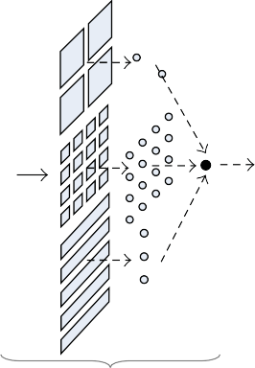
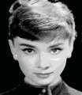
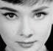



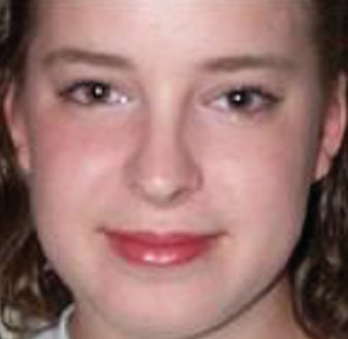
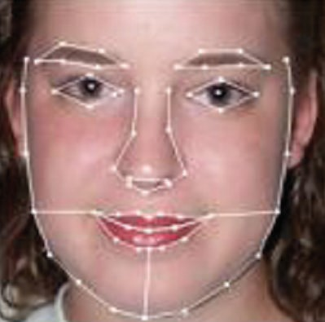
4
Advances in Artificial Neural Systems
Image
Candidate image
C1
T
C2
T
···
T
Face/ nonface
F
F
F
Nonface
AdaBoost
(a)
ANN
X  (x1, ... , x4, x5, ... , x20, x21, ... , x25)
Window 20 × 20 pixels
(b)
Figure 3: (a) The process of detecting faces of ABANN and (b) input features for neural network.
In the next subsection, we present an ASM method with a novel local texture model, which uses multilayer perceptron (MLP) for ASM local searching. MLP is very suﬃcient for face detecting [13].
Face alignment
3.1. Statistical Shape Models. A face shape can be repre-
Figure 4: Face alignment.
sented by n points (x_{i}, y_{i}) as a 2n-element vector, X =
(x₁, y₁, ... , x_{n}, y_{n})^{T} . Given s training face images, there are s
shape vectors X_{i}. Before we can perform statistical analysis
AAM method uses its global appearance model to directly conduct the optimization of shape parameters. Owing to the diﬀerent optimization criteria, ASM performs more pre- cisely on shape localization and is quite more robust to illumination and bad initialization. In the paper extent, we develop the classical ASM method to create a new method named MLP-ASM which has achieved better results.
Because ASM only uses a 1D profile texture feature,
which is not enough to distinguish feature points from their local regions, the ASM algorithm often fell into local minima problem in the local searching stage. A few representative texture features and pattern recognition methods are pro- posed to reinforce the ASM local searching, for example, Gabor wavelet [9], Haar wavelet [10], Ranking-Boost [11], and FisherBoost [12]. However, an accurate local texture model to large databases is still unachieved target.
on these vectors, it is important that the shapes represented are in the same coordinate frame. Figure 5 illustrates shape model.
In particular, we seek a parameterized model of the form
X  Model(b) (Figure 6), where b is a vector of parameters of
the model. Such a model can be used to generate new vectors, X. If we can model the distribution of parameters, p_{b}(b), we can limit them so the generated Xs are similar to those in the training set. Similarly, it should be possible to estimate p_{X} (X) using the model.
To simplify the problem, we first wish to reduce the
dimensionality of the data from 2n to something more manageable. An eﬀective approach is to apply PCA to the data. The data form a cloud of points in the 2n-D space. PCA computes the main axes of this cloud, allowing one to approximate any of the original points using a model with fewer than 2n parameters. The approach is as follows [1].

Slide 20
16
Advances in Artificial Neural Systems
S. Yan, M. Li, H. Zhang, and Q. Cheng, “Ranking prior likelihood distributions for Bayesian shape localization frame- work,” in Proceedings of the 8th IEEE International Conference on Computer Vision, pp. 51–58, October 2003.
J. Tu, Z. Zhang, Z. Zeng, and T. Huang, “Face localization via
hierarchical CONDENSATION with Fisher Boosting feature selection,” in Proceedings of the IEEE Computer Society Confer- ence on Computer Vision and Pattern Recognition (CVPR ’04), pp. I719–I724, July 2004.
S. Marcel, “Artificial neural network for pattern recogni-
tion: application to face detection and recognition,” 2004,
H. A. Rowley, S. Baluja, and T. Kanade, “Neural network- based face detection,” IEEE Transactions on Pattern Analysis and Machine Intelligence, vol. 20, no. 1, pp. 23–38, 1998.
S. Lawrence, C. L. Giles, A. C. Tsoi, and A. D. Back, “Face
recognition: a convolutional neural network approach,” IEEE Transactions on Neural Networks, Special Issue on Neural Networks and Pattern Recognition, vol. 8, no. 1, pp. 98–113, 1997.
T. H. Le, N. T. D. Nguyen, and H. S. Tran, “Landscape image
of regional tourism classification using neural network,” in Proceedings of the 3rd International Conference on Communica- tions and Electronics (ICCE ’10), Nha Trang, Vietnam, August 2010.
L. H. Thai, Building, development and application, some
combination model of neural network (NN), fuzzy logic(FL) and genetics algorithm (GA), Ph.D. thesis, Natural Science University, HCM City, Vietnam, 2004.
P. J. Phillips, H. Moon, P. J. Rauss, and S. A. Rizvi, “The FERET
evaluation methodology for face-recognition algorithms,” IEEE Transactions on Pattern Analysis and Machine Intelligence, vol. 22, no. 10, pp. 1090–1104, 2000.
R. Lienhart and J. Maydt, “An extended set of Haar-like
features for rapid object detection,” in Proceedings of the International Conference on Image Processing, September 2002.
http://www.idiap.ch/∼marcel/.
T. Kawaguchi, D. Hidaka, and M. Rizon, “Detection of eyes from human faces by Hough transform and separability filter,” in Proceedings of the International Conference on Image Processing, vol. 1, no. 2000, pp. 49–52, Vancouver, Canada, 2000.
A. L. Yuille, D. S. Cohen, and P. W. Hallinan, “Feature
extraction from faces using deformable template. Computer vision and pattern recognition,” in Proceedings of the IEEE Computer Society Conference, pp. 104–109, San Diego, CA , USA, June 1989.
L. Zhang, “Estimation of the mouth features using deformable
templates,” in Proceedings of the International Conference on Image Processing, vol. 3, pp. 328–331, Santa Barbara, CA , USA, October 1997.
P. Kuo and J. Hannah, “An improved eye feature extraction
algorithm based on deformable templates,” in Proceedings of the IEEE International Conference on Image Processing (ICIP ’05), pp. 1206–1209, September 2005.
S. L. Phung, A. Bouzerdoum, and D. Chai, “Skin segmentation
using color and edge information. Signal processing and its applications,” in Proceedings of the 7th International Sympo- sium, vol. 1, pp. 525–528, July 2003.
T. Sawangsri, V. Patanavijit, and S. Jitapunkul, “Segmentation
using novel skin-color map and morphological technique,” in Proceedings of the World Academy of Science, Engineering and Technology, vol. 2, January 2005.
M. Turk and A. Pentland, “Face recognition using eigenfaces,”
in Proceedings of the IEEE Conference on Computer Vision and Pattern Recognition, pp. 586–591, 1991.
B. A. Draper, K. Baek, M. S. Bartlett, and J. R. Beveridge,
“Recognizing faces with PCA and ICA,” Computer Vision and Image Understanding, vol. 91, no. 1-2, pp. 115–137, 2003.
M. S. Bartlett, J. R. Movellan, and T. J. Sejnowski, “Face recog-
nition by independent component analysis,” IEEE Transactions on Neural Networks, vol. 13, no. 6, pp. 1450–1464, 2002.
P. Comon, “Independent component analysis—a new con-
cept?” Signal Processing, vol. 36, no. 3, pp. 287–314, 1994.
T. T. Do and T. H. Le, “Facial feature extraction using geomet- ric feature and independent component analysis,” in Proceed- ings of the Pacific Rim Knowedge Acquisition Workshop (PKAW ’08), Hanoi, Vietnam, December 2008, (Revised Selected Papers) in Knowledge Acquisition: Approaches, Algorithms and Applications, Lecture Notes in Artificial Intelligence, Springer, Berlin, Germany, pp.231–241, 2009.
A. Hyva¨rinen and E. Oja, “Independent component analysis:
algorithms and applications,” Neural Networks, vol. 13, no. 4- 5, pp. 411–430, 2000.
O. A. Uwechue and A. S. Pandya, Human Face Recognition
using Third-Order Synthetic Neural Networks, The Springer International Series in Engineering and Computer Science, Springer, 1st edition, 1997.

Slide 21
literature review for face recognition
Many organizations draw their attention to maintain high information security level and control the grant access to the system by authenticating the individual's identity to evade cybercrime issues. On the other hand, standard authentication techniques such as PIN, password, username, ID card number, etc., become inefficient techniques. With the excessive advances in software computing and image processing, many emerging methodologies appeared mainly to improve the authentication procedure (Bhattacharyya et al., 2009). The "Biometric" word is constructed through combing "Bio" and "metrics" words which refer to useful sciences that concern is analysing and measuring biological information through adapting intelligence machine learning and various mathematical algorithms. Nowadays, Biometrics Pattern Recognitions (BPR) methodologies are widely useable systems. It was defined as an efficient information system that is mainly employed to detect, verify, and authenticating individuals' true identity based on some of its behavioural characteristics like body movement, keystroke writing style, and unique physiological factors such as fingerprint, eye retina, or eye iris, voice pattern, DNA, facial pattern and handshape (Bhattacharyya et al., 2009).

Slide 22
The recent development in machine learnings and technologies; makes it possible to generate an intelligence system based on statistical learning methodologies as a Facial Recognition (FR). Although, the FR system is considered one of the significant applications in image processing. However, this form of recognition may deliver great challenges in computer vision and pattern recognition due to many reasons such as diversities in facial expressions, orientation problems, illumination effects, and image size and background complexity (Khan et al., 2019). Although many researchers place considerable efforts in this area to overcome the limitations of FR through the use of the Artificial Neural Network approach, many issues are still required to be solved. In general, the FR system analyzes the individual's facial characteristics from an image that is entered as input into the system. This image will go through a reprocess phase to extract all essential information based on using specific algorithms like the Deep Learning Algorithm (DLA) to recognize the target individual at the end (Khan et al.,2019)
In the last decade, various models and architectures of Artificial Neural Network (ANN) have been developed and widely utilized for face detection and recognition based on the neural network (Kasar et al., 2016). An Artificial Neural Network (ANN) is an information processing paradigm that behaves like biological nervous systems. ANN is a powerful mathematical tool that processes input information to efficiently simulate or predicate the desired output data (Yousif & Sembokb2006a; Yousif & Sembokb2006b). Many ANN models are adapted in the development of different multi-view face recognition systems because these models have great ability and essential roles to efficiently simulate the methodology of neurons work and structure like in the human brain (Boughrara et al., 2012). Therefore, a Neural network (NN) is considered a robust classification methodology that works correctly in non-linear or linear datasets. It had been employed not only for face recognition applications but also in diverse areas such as fingerprint recognition, voice recognition, iris recognition, Natural Language processing, etc. (Yousif & Sembokb2005; Yousif & Fekihal 2012).

Slide 23
Conclusion Recently, different emerging techniques have been generated to improve identification and authenticating procedure for individuals and overcome weaknesses of traditional identification techniques. This paper aims to review and critically analyze the current methods to improve detection and validate the images. Also, the results show that the Biometric pattern recognitions are one of these modern techniques that have been applied widely to improve and enhance security levels and access control.
Moreover, in computer vision and image processing, face recognition/detection systems became one of the most popular applications, and a deep research area is much needed. Most researchers aim to solve common problems due to human face diversities and image issues such as illumination and lighting variation, background complexity, orientation issue, etc. Most of these problems had been addressed in many research papers. Researchers employ the ANN approach and several analysis techniques like Principal Component Analysis (PCA) to improve efficiency, performance, and computation time in the image processing procedure. These research papers cover the concept of Biometric Pattern Recognition and ANN. In brief, it explains the fundamental phases for developing any FR system and describes the work procedure of ANN. Besides, it represents different literature studies related to constructing FR based on different ANN architecture.

Slide 24
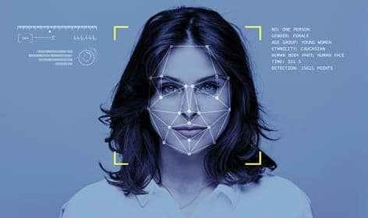
The concept of face recognition isn’t the newest subject in computer vision and for many past decades researcher's grape their attention in this area due to its practical importance and great abilities in enhancing the way of verification and authenticating an individual's identity. Despite the fact that state other identification methods like fingerprint, iris scanning, etc., are classified as more accurate identification tools, "face recognition has always remained as a major focus of most researchers because it is people's primary technique for identifying individual "(Kasar et al., 2016). There are many of literature studies that focus on studying the modern ANN architectures and models which could be applied for constructing a successful face recognition system as shown in Table 1

Slide 25
References
[1]. Al-Hatmi, M. O., & Yousif, J. H. (2017). A review of Image Enhancement Systems and a case study of Salt &pepper noise removing. International Journal of Computation and Applied Sciences (IJOCAAS), 2(3), pp 217-223.
[2]. Agarwal, M., Jain, N., Kumar, M. M., & Agrawal, H. (2010). Face recognition using eigen faces and artificial neural network. International Journal of Computer Theory and Engineering, 2(4), pp 624. [
3]. Bhattacharyya, D., Ranjan, R., Alisherov, F., & Choi, M. (2009). Biometric authentication: A review. International Journal of u-and e-Service, Science and Technology, 2(3), pp 13-28.
[4]. Bhele, S. G., & Mankar, V. H. (2012). A review paper on face recognition techniques. International Journal of Advanced Research in Computer Engineering & Technology (IJARCET), 1(8), pp 339-346.
[5]. Bojkovic, Z., & Samcovic, A. (2006, September). Face detection approach in neural network based method for video surveillance. In 2006 8th Seminar on Neural Network Applications in Electrical Engineering (pp 44-47). IEEE.
[6]. Boughrara, H., Chtourou, M., & Amar, C. B. (2012, May). MLP neural network based face recognition system using constructive training algorithm. In 2012 international conference on multimedia computing and systems (pp. 233-238). IEEE.
[7]. Bouzerdoum, A. (2000, July). Classification and function approximation using feed-forward shunting inhibitory artificial neural networks. In Neural Networks, IEEE-INNS-ENNS International Joint Conference on (Vol. 7, pp 6613-6613). IEEE Computer Society.
[8]. Hazem M. El-Bakry (2002), Face Detection Using Neural Networks and Image Decomposition Lecture Notes in Computer Science Vol. 22, pp 205-215.
[9]. Huang, L. L., Shimizu, A., Hagihara, Y., & Kobatake, H. (2003). Face detection from cluttered images using a polynomial neural network. Neurocomputing, 51, pp 197-211.
[10].Kasar, M. M., Bhattacharyya, D., & Kim, T. H. (2016). Face recognition using neural network: a review. International Journal of Security and Its Applications, 10(3), pp 81-100.
[11].Kaushal, A., & Raina, J. P. S. (2010). Face detection using neural network & Gabor wavelet transform. IJCST, 1(1)

Slide 26
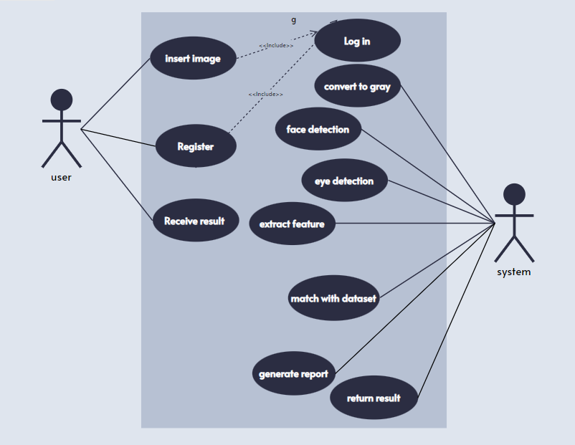
use case diagram :
Main Function:
Insert_Image
Face_Detection
Face_Recognation

Slide 27
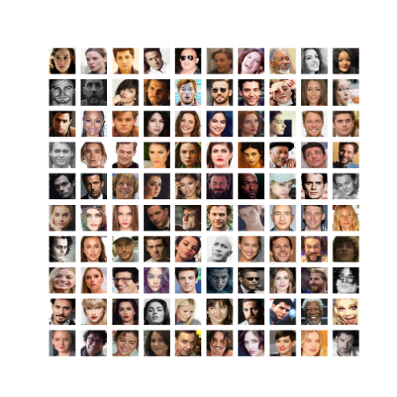

The Dataset
Pins Face Recognition : https://www.kaggle.com/datasets/hereisburak/pins-face-recognition/code

Slide 28

Artificial Neural Network algorithm [ANN]

Slide 29
What is Neural Network? An Artificial Neural Network (ANN) is an information processing paradigm that is inspired by the way biological nervous systems, such as the brain, process information. The key element of this paradigm is the novel structure of the information processing system. It is composed of many highly interconnected processing elements (neurons) working in unison to solve specific problems. ANNs, like people, learn by example. An ANN is configured for a specific application, such as pattern recognition or data classification, through a learning process.
Learning in biological systems involves adjustments to the synaptic connections that exist between the neurons. This is true of ANNs as well. Artificial Neural Networks are being touted as the wave of the future in computing. They are indeed self-learning mechanisms which don't require the traditional skills of a programmer. But unfortunately, misconceptions have arisen. Writers have hyped that these neuron-inspired processors can do almost anything. These exaggerations have created disappointments for some potential users who have tried, and failed, to solve their problems with neural networks. These application builders have often conclude that neural nets are complicated and confusing. Computers have trouble recognizing even simple patterns much less generalizing those patterns of the past into actions of the future.

Slide 30
Why we use Neural network?
Neural networks, with their remarkable ability to derive meaning from complicated or imprecise data, can be used to extract patterns and detect trends that are too complex to be noticed by either humans or other computer techniques. A trained neural network can be thought of as an "expert" in the category of information it has been given to analyze. This expert can then be used to provide projections given new situations of interest and answer "what if" questions.
Other advantages include:
Adaptive learning: An ability to learn how to do tasks based on the data given for training or initial experience.
Self-Organization: An ANN can create its own organization or representation of the information it receives during learning time.
Real Time Operation: ANN computations may be carried out in parallel, and special hardware devices are being designed and manufactured which take advantage of this capability.
4. Fault Tolerance via Redundant Information Coding: Partial destruction of a network leads to the corresponding degradation of performance. However, some network capabilities may be retained even with major network damage.

Slide 31
Convolutional neural network [CNN]

Slide 32
What is CNN
CNN is a type of deep learning model for processing data that has a grid pattern, such as images, which is inspired by the organization of animal visual cortex [13, 14] and designed to automatically and adaptively learn spatial hierarchies of features, from low- to high-level patterns. CNN is a mathematical construct that is typically composed of three types of layers (or building blocks): convolution, pooling, and fully connected layers. The first two, convolution and pooling layers, perform feature extraction, whereas the third, a fully connected layer, maps the extracted features into final output, such as classification. A convolution layer plays a key role in CNN, which is composed of a stack of mathematical operations, such as convolution, a specialized type of linear operation. In digital images, pixel values are stored in a two-dimensional (2D) grid, i.e., an array of numbers (Fig. 2), and a small grid of parameters called kernel, an optimizable feature extractor, is applied at each image position, which makes CNNs highly efficient for image processing, since a feature may occur anywhere in the image. As one layer feeds its output into the next layer, extracted features can hierarchically and progressively become more complex. The process of optimizing parameters such as kernels is called training, which is performed so as to minimize the difference between outputs and ground truth labels through an optimization algorithm called backpropagation and gradient descent, among others.

Slide 33
How is CNN different from other methods employed in radiomics?
Most recent radiomics studies use hand-crafted feature extraction techniques, such as texture analysis, followed by conventional machine learning classifiers, such as random forests and support vector machines . There are several differences to note between such methods and CNN. First, CNN does not require hand-crafted feature extraction. Second, CNN architectures do not necessarily require segmentation of tumors or organs by human experts. Third, CNN is far more data hungry because of its millions of learnable parameters to estimate, and, thus, is more computationally expensive, resulting in requiring graphical processing units (GPUs) for model training.

Slide 34
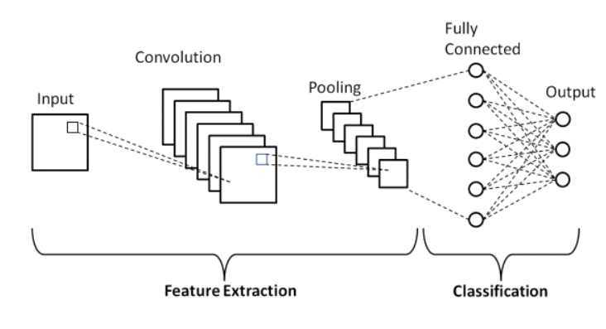
Basic Architecture
There are two main parts to a CNN architecture
*A convolution tool that separates and identifies the various features of the image for analysis in a process called as Feature Extraction.
*The network of feature extraction consists of many pairs of convolutional or pooling layers.
*A fully connected layer that utilizes the output from the convolution process and predicts the class of the image based on the features extracted in previous stages.
*This CNN model of feature extraction aims to reduce the number of features present in a dataset. It creates new features which summarises the existing features contained in an original set of features. There are many CNN layers as shown in the CNN architecture diagram.

Slide 35
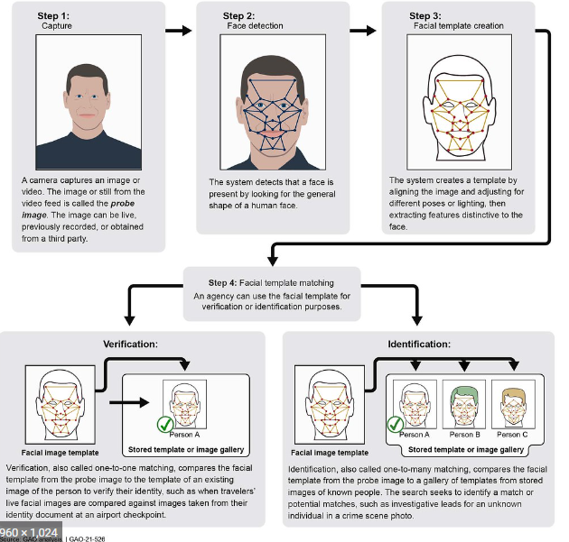

Slide 36
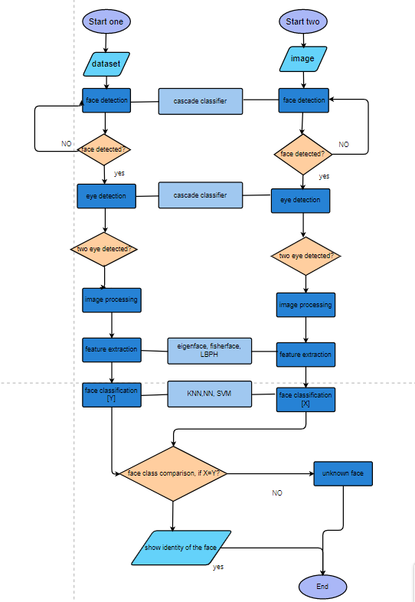
Flowchart :
Notes:
Flowchart

Slide 37
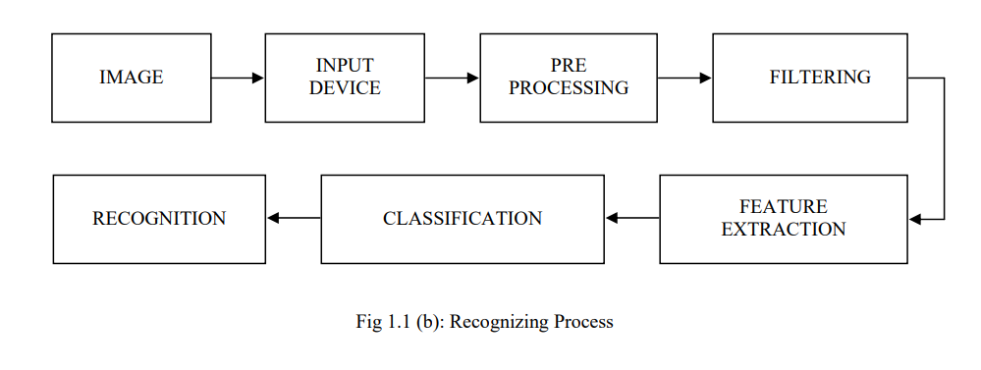
Block diagram for face recognition

Slide 38
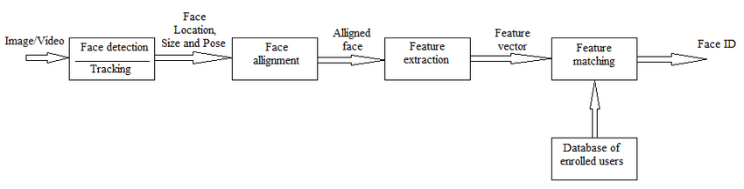
Flow diagram

Slide 39

DEVELOPMENT PLATFORM
Environment
The platform we use is Spyder. the Syder is useful and reliable Python software that features advanced editing, tools for data inspection, interactive testing and debugging. Also, it embeds Python specific code quality . we use it because we can choose a specific part of code and run it if we want instead of running all the code at once
Used libraries
cv2
pandas
matplotlib
Seaborn
Numpy
Keras
tensorflow

Slide 40
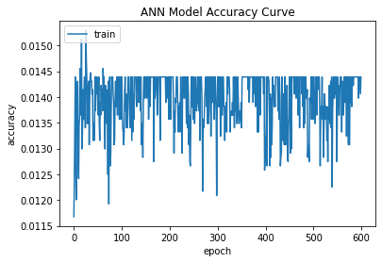
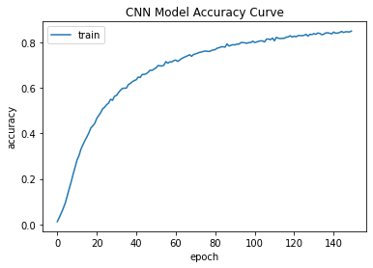
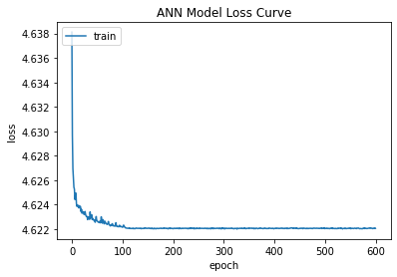
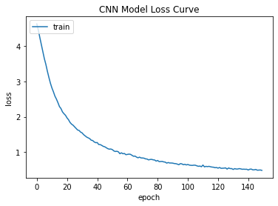
Plots of the evolution or training

Slide 41


samples of the output
The System With GUI :

Slide 42


Slide 43

The results and insights :
During the running, we found that some of the results are incorrect, or that one of the algorithms works correctly and the other is inaccurate

Slide 44
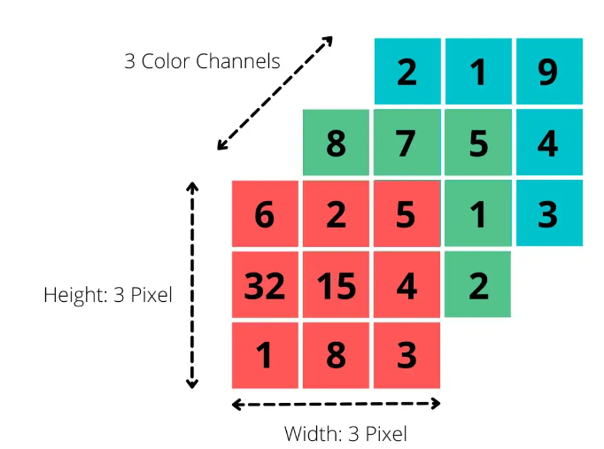
Why did the algorithm [ANN] behave in such a way?
For the computer, an image in RGB notation is the summary of three different matrices. For each pixel of the image, it describes what color that pixel displays. We do this by defining the red component in the first matrix, the green component in the second, and then the blue component in the last. So for an image with the size 3 on 3 pixels, we get three different 3x3 matrices.
To process an image, we enter each pixel as input into the network. So for an image of size 200x200x3 (i.e. 200 pixels on 200 pixels with 3 color channels, e.g. red, green and blue) we have to provide 200 * 200 * 3= 120,000 input neurons. Then each matrix has a size of 200 by 200 pixels, so 200 * 200 entries in total. This matrix then finally exists three times, each for red, blue, and green. The problem then arises in the first hidden layer, because each of the neurons there would have 120,000 weights from the input layer. This means the number of parameters would increase very quickly as we increase the number of neurons in the Hidden Layer. Additionally, due to a large number of parameters, the network would very likely stop attending to individual image details as they would be lost in sheer mass.
And that’s happen when using Fully connected neural networks (FCNNs) which are a type of artificial neural network where the architecture is such that all the nodes, or neurons, in one layer are connected to the neurons in the next layer.

Slide 45
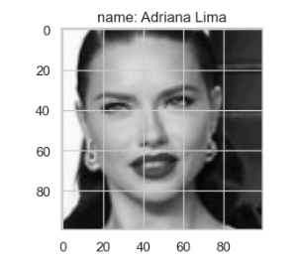
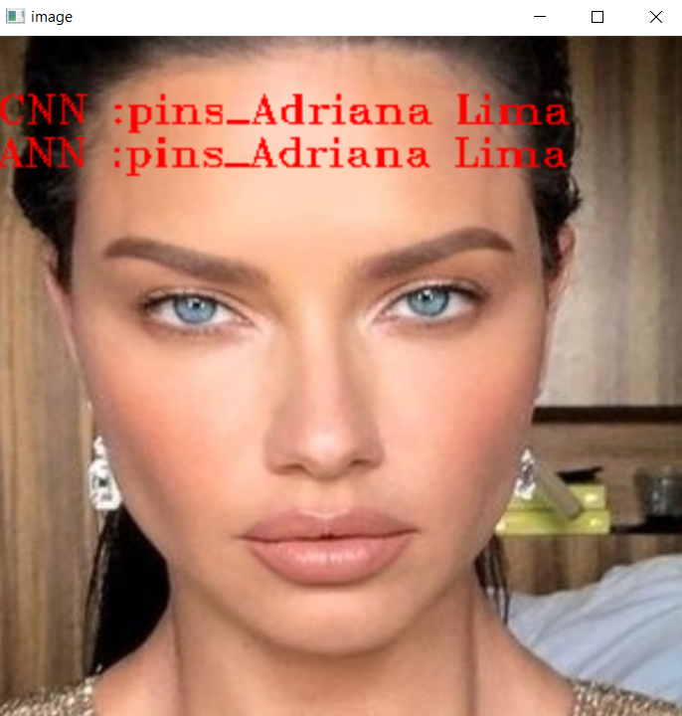
That’s what happened during evolution
That was the result

Slide 46
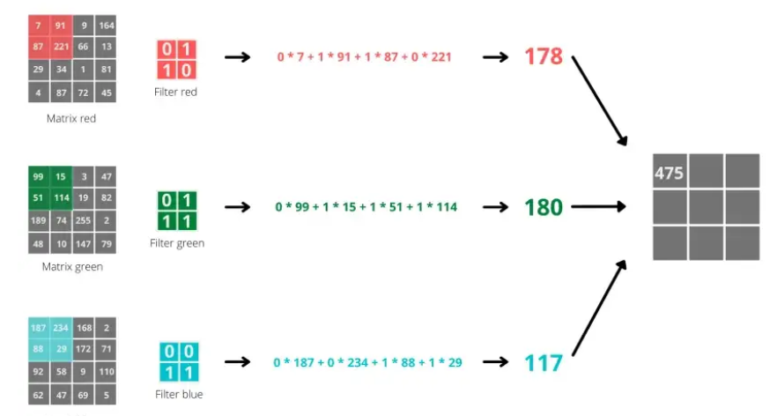
Why did the algorithm [CNN] behave in such a way?
For these reasons, the Convolutional Neural Network takes a different approach, mimicking the way we perceive our environment with our eyes. When we see an image, we automatically divide it into many small sub-images and analyze them one by one. By assembling these sub-images, we process and interpret the image.
The work happens in the so-called convolution layer. To do this, we define a filter that determines how large the partial images we are looking at should be, and a step length that decides how many pixels we continue between calculations, i.e. how close the partial images are to each other. By taking this step, we have greatly reduced the dimensionality of the image.
But there was another problem with the algorithm
Convolutional Neural networks (CNN) have great performance while classifying images which are very similar to the dataset . However, If the images contain some degree of tilt or rotation then CNNs usually have difficulty in classifying the image
If the CNN takes an image along with some noise it recognizes the image as a completely different image whereas the human visual system will identify it as the same image with the noise. This also proves that CNNs are using very different information from a regular visual system in order to recognize images.

Slide 47
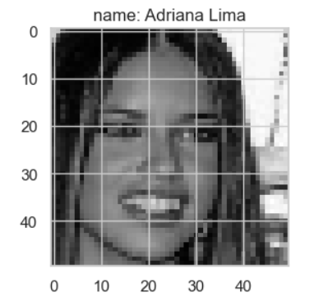

That’s what happened during evolution
That was the result

Slide 48
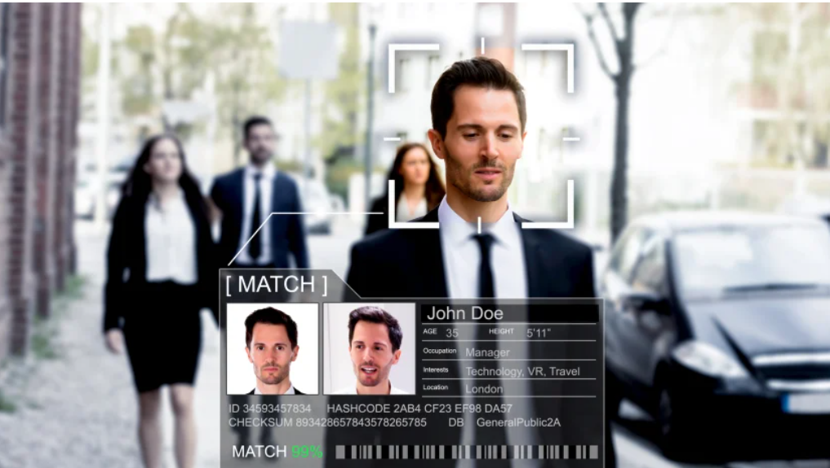
Pros of facial recognition:
1. Finding missing people and identifying perpetrators
Law enforcement agencies use facial recognition to identify criminals with no other means of identification and to locate missing people by comparing faces captured on camera feeds with those on watch lists.
Facial recognition has also been used to find missing children. Often, this is a result of the technology being used in tandem with advanced ageing software, which can use photos of children at the time of their disappearance to predict what they look like at present. Police using facial recognition are privy to live alerts and can investigate potential matches in real time.
2. Protecting businesses against theft
Facial recognition software has been used as a preemptive measure against shoplifting. Business owners use the software and security cameras to identify suspects against a database of known thieves
, and it has been argued that the mere presence of facial recognition
cameras has an effect as a deterrent for would-be offenders.
If something is stolen from the business, the software
can also be used to catalogue the thieves for future reference.
3. Better tools for organising photos
Facial recognition can also be used to tag photos in your cloud storage through iCloud or Google Photos. Users who wish can enable facial recognition in their respective photo app’s settings, resulting in named folders for regular photo subjects. Facebook also used facial recognition to suggest people to tag within a photo.

Slide 49
Cons of facial recognition:
1.The threat to individual privacy is a significant downside of facial recognition technology.
Privacy is such a big issue that some cities, including San Francisco, California and Cambridge, Massachusetts, have banned law enforcement’s use of real-time facial recognition surveillance. In these cases, police can use video recordings from personally owned security video devices, but they can’t use live facial recognition software.
2. Can infringe on personal freedoms
Being recorded and scanned by facial recognition technology can make people feel like they’re always being watched and judged for their behaviour.
Plus, police can use facial recognition to run everyone in their database through a virtual criminal lineup, akin to treating you as a criminal suspect without probable cause.
For example, the aforementioned example of facial recognition being used to catalogue potential shoplifters has led to problems for companies such as Southern Co-operative, which recently faced a legal complaint for its widespread use of FR CCTV in its shops.
5. Provides opportunities for fraud and other crimes
Lawbreakers can use facial recognition technology to perpetrate crimes against innocent victims too. They can collect individuals’ personal information, including imagery and video collected from facial scans and stored in databases, to commit identity fraud.
With this information, a thief could take out credit cards and other debt or open bank accounts in the victim’s name. In consideration of the aforementioned use of facial recognition to place shoplifters on criminal databases, threat actors could even place individuals on a criminal record.

Slide 50
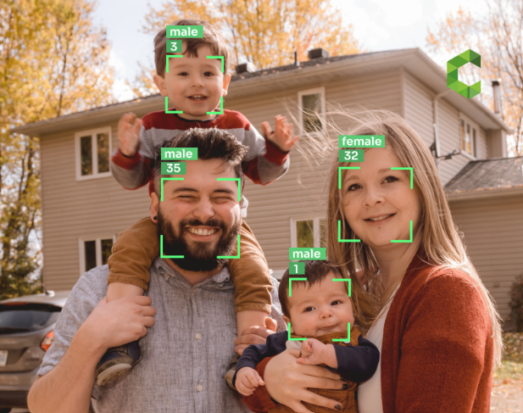
Future Work
With the increasing ubiquity of cameras and with the advent of selfies, the number of facial images available in the world has skyrocketed. Consequently, there has been a growing interest in automatic age and gender prediction of a person using facial images, so In the future, we will work on developing the CNN algorithm in order to provide new capabilities for the system to identify the person, age and gender.

Slide 51
https://drive.google.com/drive/folders/1Zb0sLUS2aXI0-t7nol4qz1FcouLgy3t1?usp=sharing

Slide 52
Thanks

